Slide 1
JAVA MINI PROJECT – EMAIL SENDING APPLICATION
TEAM MEMBERS:
JAYASHEELAN R - 19IT037
MOHAN KUMAR R – 19IT059
SREE VIGENSH K - 19IT102

Slide 2
DESCRIPTION:
Email sending application is our mini project.
We used swing library for front end working of the application , and some jar files like activation and javax.mail for authenticating the user and sending email, and some file management libraries.
With this application we can send email quickly without opening any web browser software.

Slide 3
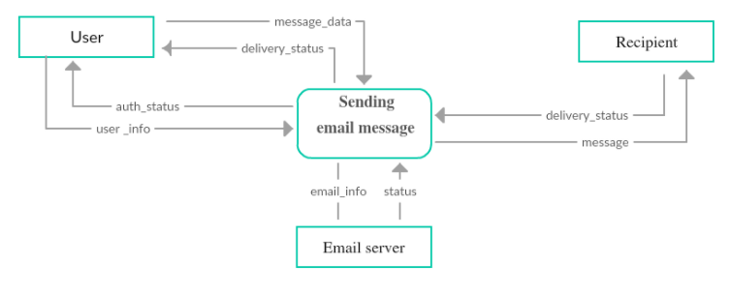

Slide 4

CODE:
EMAIL APPLICATION JAVA CODE

Slide 5
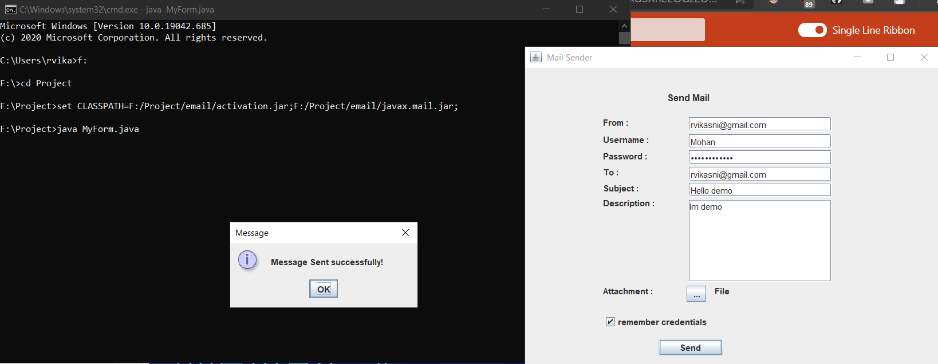

Slide 6
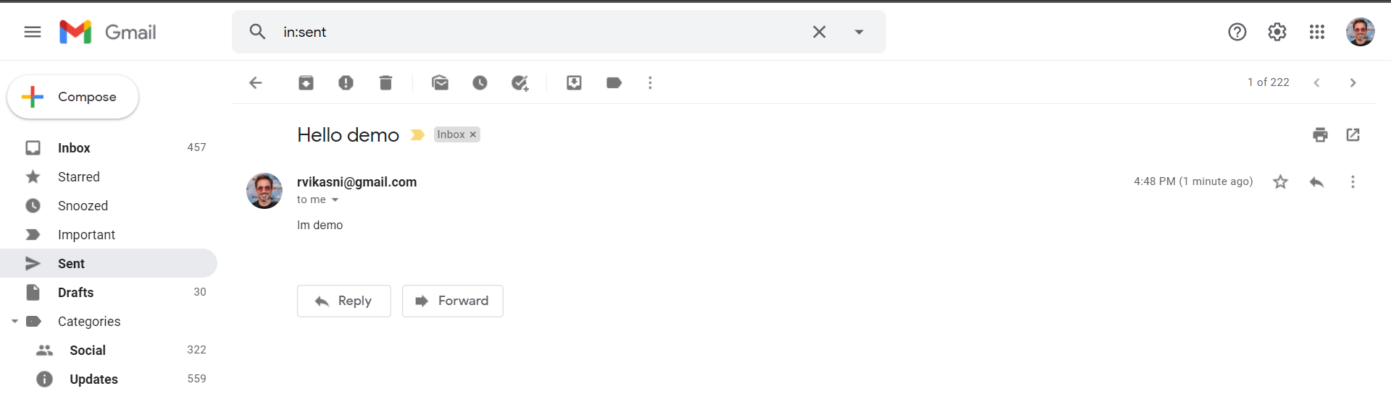
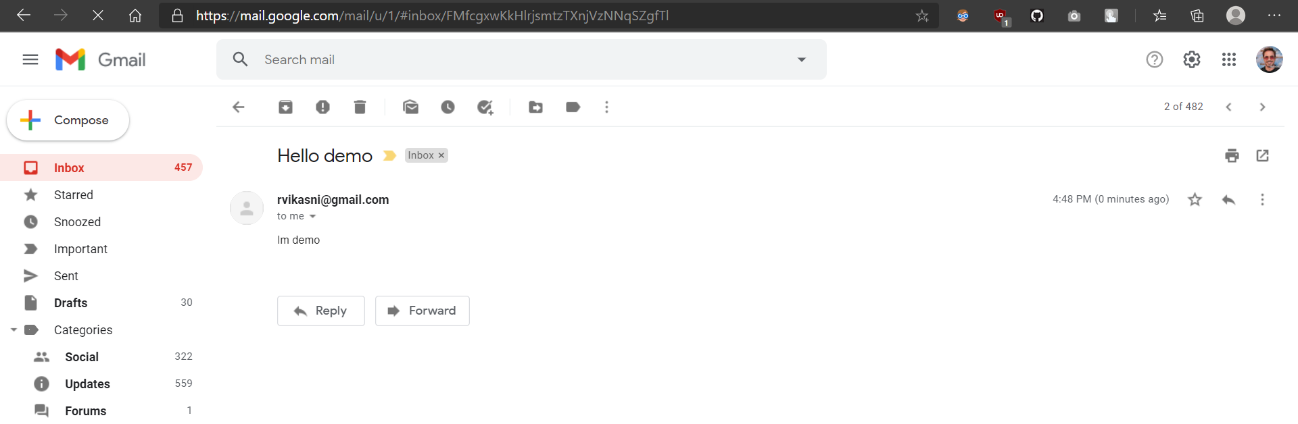
From sent section
In INBOX of recipient

